Slide 1
Capstone Project
By: Shikher Singh
Mentor: Ankit Jain

Slide 2
Data-Set Default of credit card client data-set
Source: UCI machine learning
Abstract:
Number of Instances(30000)
Attributes (Integer, real)
Number of attributes(24): Amount of given credit to individual or family, gender, education status, marriage status, Age, History of payment( from April-September,2005), Amount of bill statement( from April-Sep,2005), Amount of previous payment(from April –Sep, 2005)

Slide 3
Problem Statement : This research aimed at the case of customers @ default payments and compares the predictive accuracy of probability of default among different classification methods. From the perspective of risk management, the result of predictive accuracy of the estimated probability of default will be more valuable than the binary result of classification - credible or not credible clients.
What to achieve: Y(0= No, 1= yes)
Whether client default on their credit card payment.

Slide 4
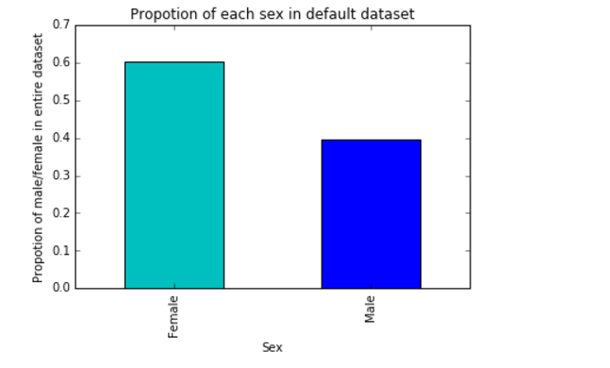
Data exploration & Facts:
Proportion of females/males in dataset

Slide 5
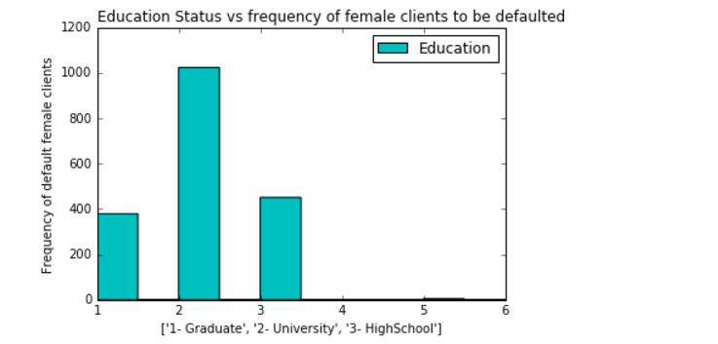
Married university passed out females are more likely to default than who are graduates/high-school passed out

Slide 6
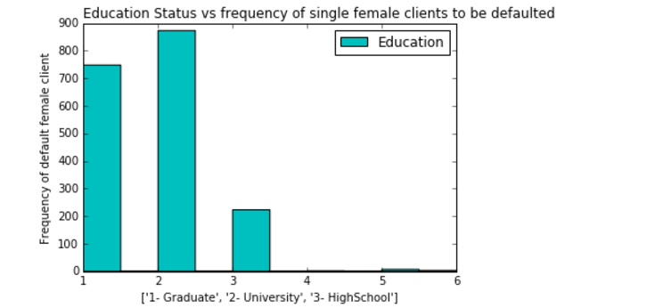
Single female university students are also likely to default more in comparison to graduate student.

Slide 7
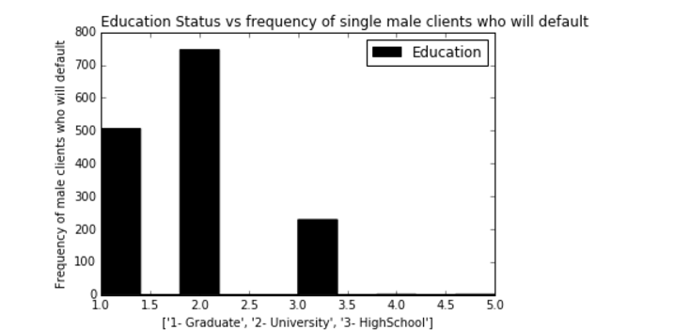
Single males who are university passed out also likely to default as compared to graduates.

Slide 8
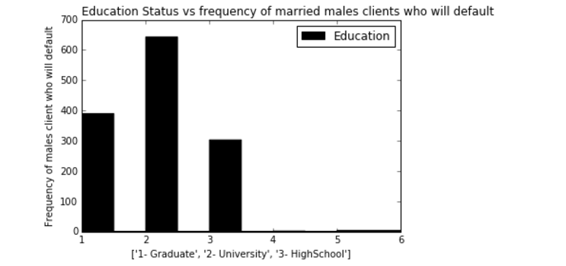
Married university passed out males are also more likely to default than graduates are

Slide 9
Recommendations:
Try to provide credit cards to males more as compared to females.
Always do education status check before providing cards to the client as proportion of default is very high in university passed out.
Plan to give lower limit schemes for university passed out males/females so that they are less likely to default.

Slide 10
Requirement of machine learning:
Will try to maximize probability of default among females as well as males.
To achieve this result, will build classification models

Slide 11
Supervised learning methods:
RandomForest : combination of ensemble methods
SVM : features should be scalable
Logistics regression: hyper-parameters
KNN: best neighbors to be picked
NaiveBayes: features should be independent

Slide 12
Logistics Regression:
Features to be excluded: Initial amount of balance given, bill amount in last 3 months as well as amount of previous statements in last 5 months excluded
Cross-validation : regularized parameter(C=1) was the best estimator
Max accuracy obtained: 79.53 (better than before)

Slide 13
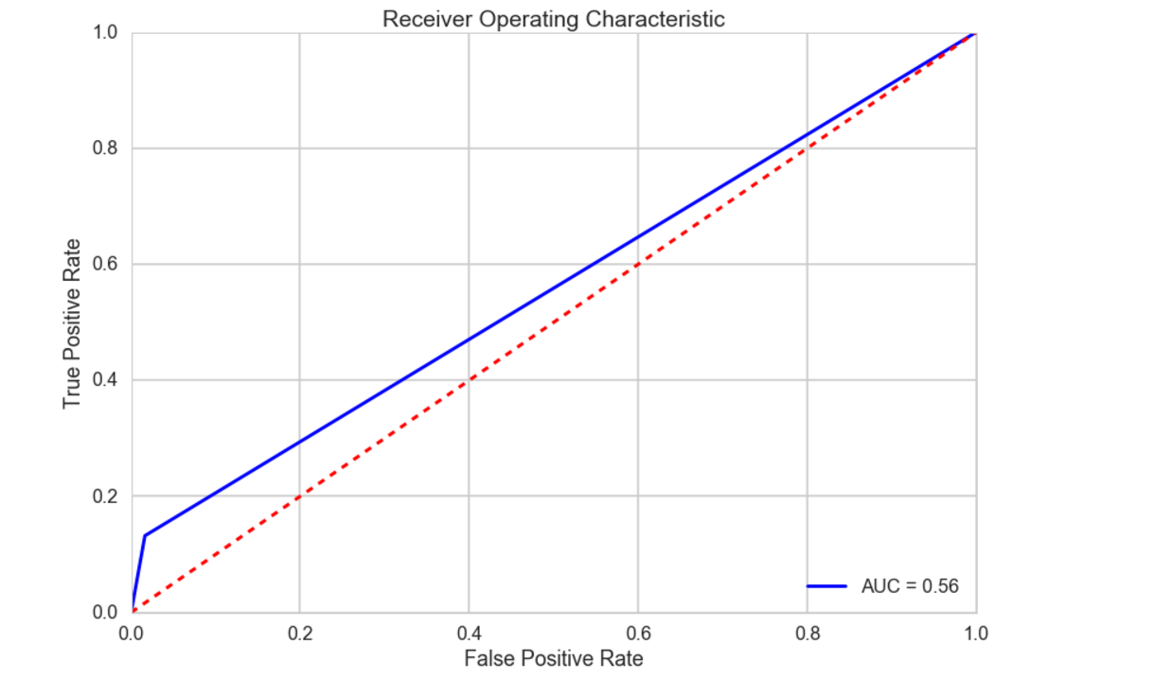
Roc-curve

Slide 14
Support Vector Machine
Features should be normalized.
Used cross-validation to get best Slack(C) and Gamma.
C=1, Gamma= 0.001, Kernel= RBF
Optimized accuracy: 78.24 %
Took more time to train the model

Slide 15
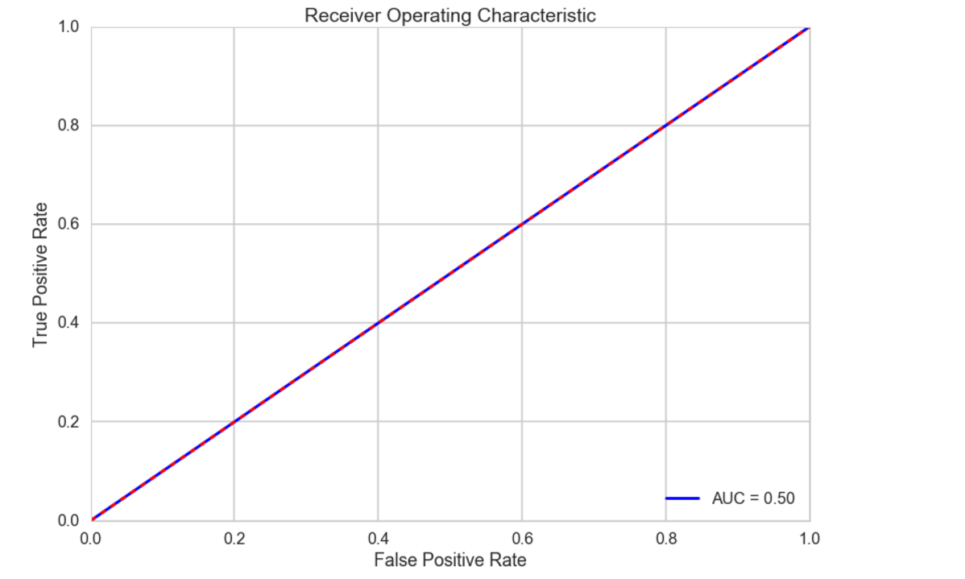
Roc-curve

Slide 16
K Nearest Neighbour:
Same features were excluded as was in Logistics Regression
Cross-validation was used to pick optimized value of neighbours
Neighbors-30
Accuracy achieved: 78.65%

Slide 17
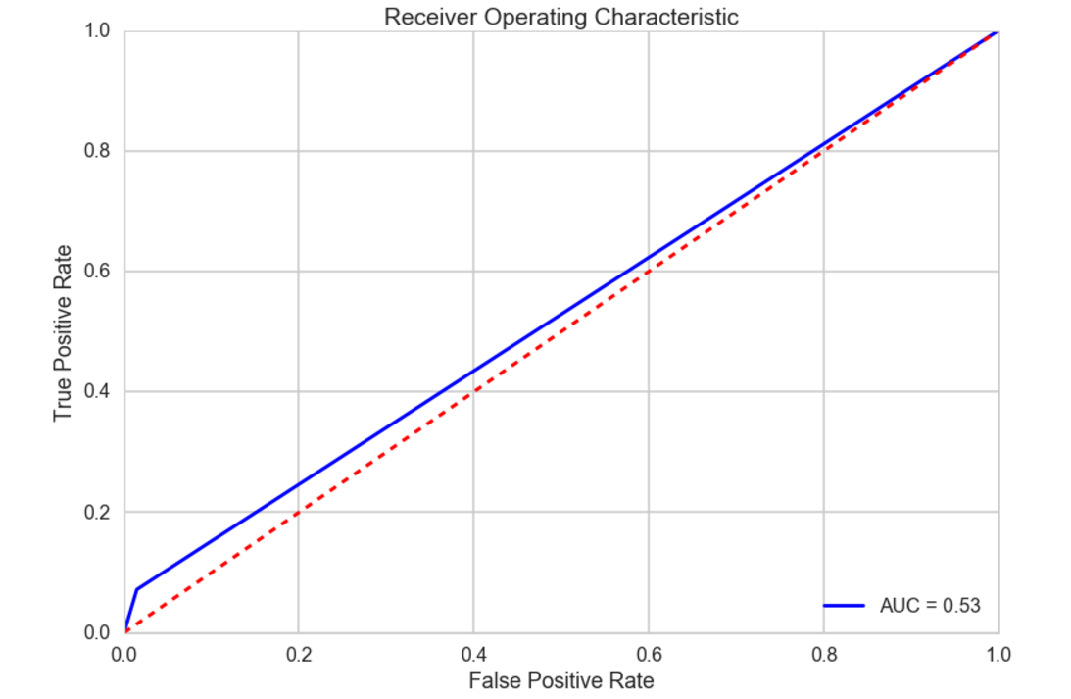
Roc-curve

Slide 18
NaiveBayes
Initial accuracy achieved was 36 percent and thought of reject naive-Bayes.
Go for independent features
Accuracy score achieved was 80.38% percent

Slide 19
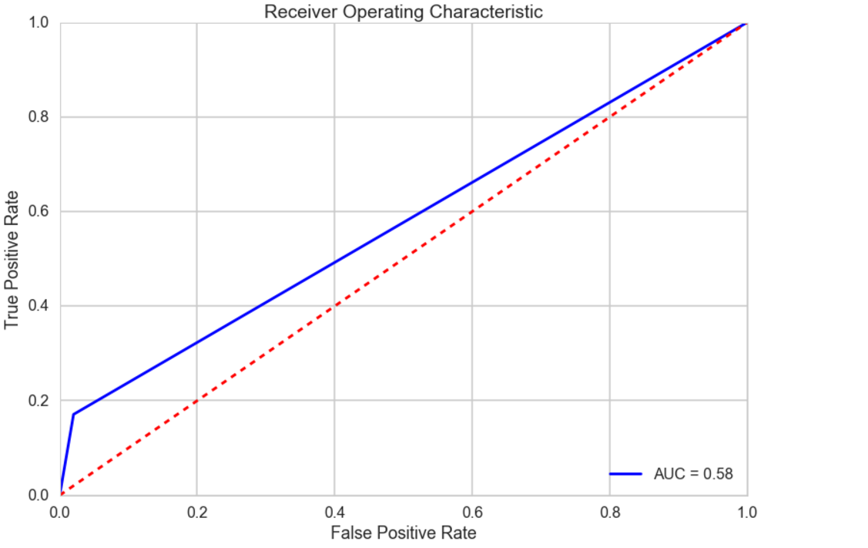
Roc-curve

Slide 20
RandomForest: The saviour
Why??

Slide 21
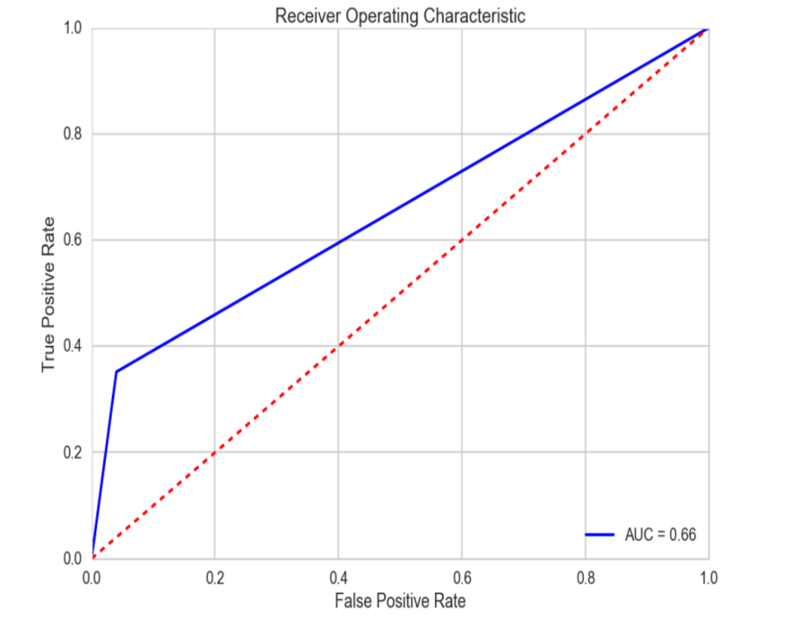



RandomForest
NaiveBayes
KNN
SVM

Slide 22
No normalization needed
More features were excluded such as history of payments for last 4 months
Pretty fast
Cross-validation were used to pick best features(Number of trees-20, maximum depth-7)
Accuracy score achieved: 82.77 %
So far the best estimator

Slide 23
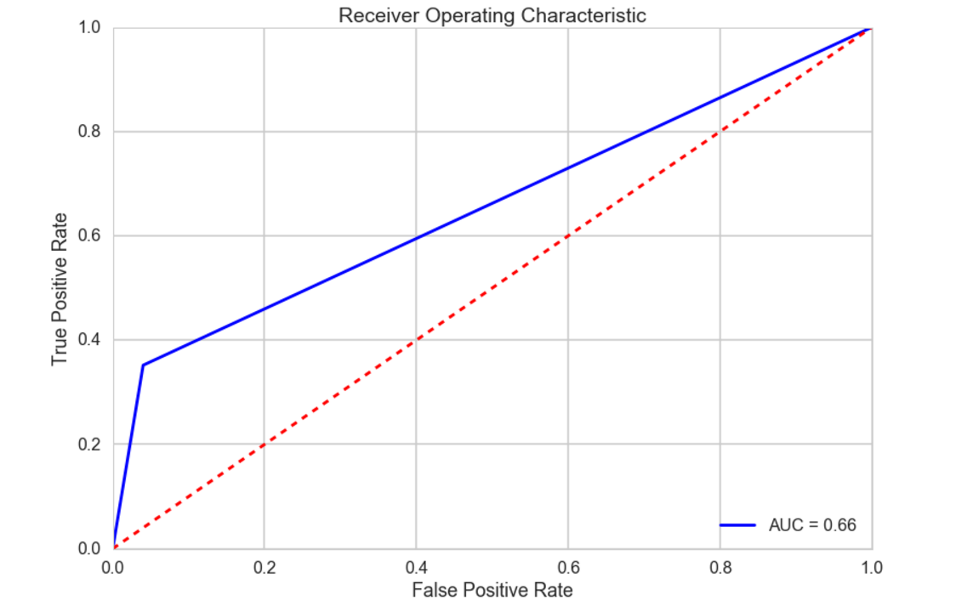
Roc-curve

Slide 24
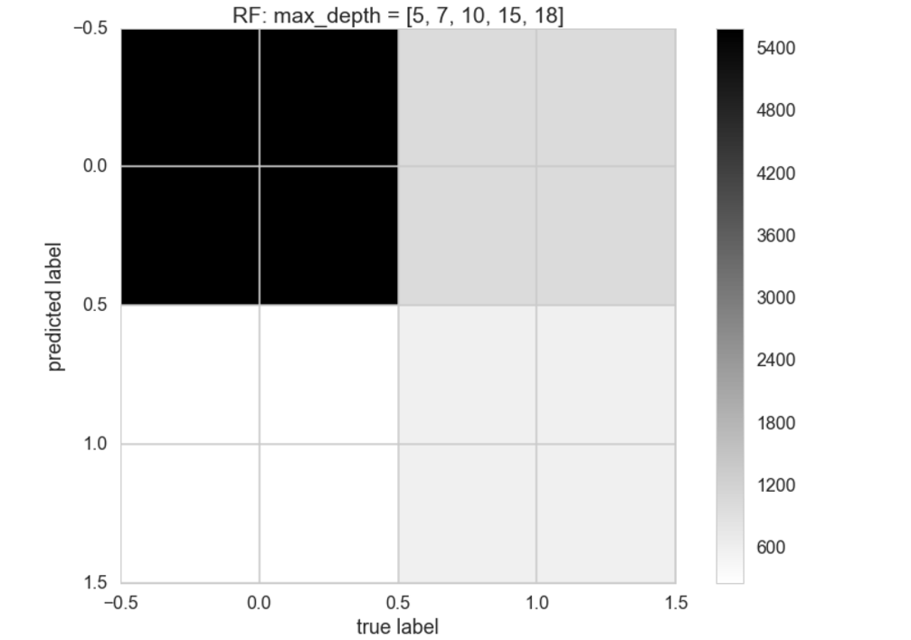

Slide 25
Q & A

Slide 26
If No question,
please provide more suggestions how to make it better model

